Slide 1

HackYourCareer
Employability Skills Workshop for HYF
Notes:
Key to understand: You are approaching the end of your 6 month participation in HYF where you’ve learned – hopefully! – full stack Java development, preparing you for a career as a developer.
NOW The focus is shifting:
Focus of HYF has been on equipping you with the skills needed to be a successful “entry level” developer – something of a ONE WAY STREET
Now your journey becomes a TWO WAY STREET
Also about YOU but also about the organization you will work for – what you have to offer, what you can do to help the organization achieve its objectives.
The purpose of this workshop – and next week’s follow up session - focus on specific things you need to do to help to prepare for this important transition

Slide 2
Agenda
Why are we here?
Build your brand: CV, LinkedIn, Cover letter
Interviewing
Dutch Workplace
Finding Opportunities

Slide 3
Why Are We Here?
Open discussion
Training in marketable skills
Figure out what you want to do
Get a job
Become a productive member of Dutch society

Slide 4
Build Your Brand - CV
Must have one
Personal “sales brochure”
First point of contact
Lot’s of competition
Get it right and keep it up to date
Notes:
CV used to be most important, now equal in importance to LinkedIn profile.
Must have – always required
CV, LI profile and (sometimes) cover letter are your “passport” into the world of employment
Personal sales brochure – you will be judged by your CV for better or worse
First date – first impressions matter the most, so spend time on getting it right
Competition – even in development, there is still a lot of competition for the best roles in the best organizations
Get it right from the beginning and Keep it up to date JUST IN CASE

Slide 5
Build Your Brand - CV
V1 More Experience | V2 Less Experience
Summary | Summary
Skills – hard, soft | Skills – hard, soft
Experience | Education
Education | Additional Training
Additional Training | Experience
Languages | Languages
See template
Notes:
Different from LI profile, more specific to the role you are applying for
PDF
Avoid coloured paper or type, fancy fonts, photographs or clever delivery approaches
Be truthful and don't be afraid to sell your skills
Keep the look simple and make your point quickly (download our CV template as a guide)
Use the past tense and choose strong action verbs
Avoid speaking about yourself in the third person
Avoid jargon and acronyms that other people might not understand
Tailor your resume for each specific application
Make your CV results oriented: give proof to back up your capability statements.
Personal Information: Include your name, full address, telephone numbers (day/evening/mobile) and email address.
Make it perfect, but there is no magic!

Slide 6
Build Your Brand – Cover Letter
Format
Address line
Salutation
Body – Brief summary of background and qualifications, refer to role, why interested
Close
See template
Notes:
Also referred to as a Motivation Letter. Not as important as used to be, might never use one
Can also be the text of an email
Can have one letter and customize for each role – Company, Role
Will send a standard format for cover letter, also plenty of examples on the internet.
PDF

Slide 7
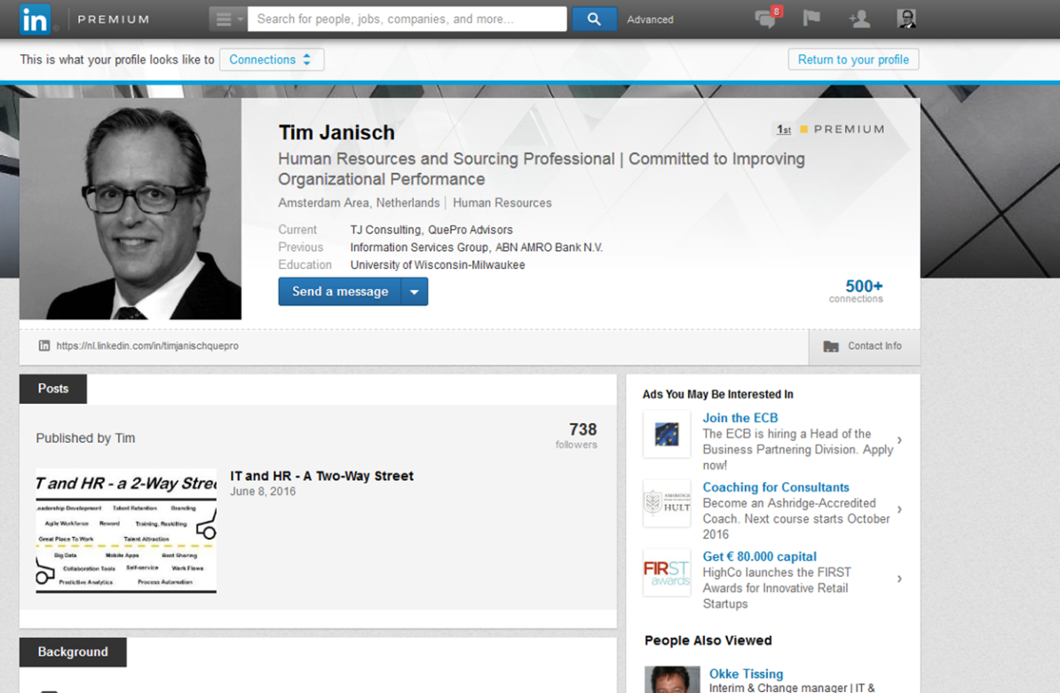
Build Your Brand - LinkedIn
Why? Largest professional network – 350M members
Public face
Network
Opportunities
Research
Stay current
Notes:
Public profile (not social networking)
What to use it for:
Build your network
Look for opportunities
Learn about developments in your industry.
Join and participate in groups
Learn new things
Research organizations

Slide 8
LinkedIn - Profile
Profile photo
Summary
Industry and postal code
Current position with description
Two or more positions
Education
At least five skills
At least 50 connections
Work samples or projects
Volunteer experience
Notes:
At a minimum
Good English, no typos! Same with Cover Letter and CV – thank goodness for spell checker!
Profile
Connections
Groups
Companies
Jobs
Updates
Mobile
Upgrade account

Slide 9
Interviewing
Most critical step
Why interview? Two-way street
Structure
What are employers looking for?
Notes:
Now you have an idea about what you want to do, you have a perfect
perfect CV cover letter and LI profile,
found an interesting opportunity,
Now you are invited for an interview, and the real fun begins, the most critical step
Why interview? The job or employment interview is a CONVERSATION between you and a potential employer to determine if the employer will hire you, but also a Two way street, an opportunity for the org to assess you as well as an opportunity for you to determine if the org is the right fit with YOUR skills and interests.
May be Structured or unstructured, large v small organizations

Slide 10
What Are Employers Looking For?
Help organization achieve its goals!
Communication skills
Honesty
Technical skills
Work ethic
Flexibility
Determination, persistence
Work in harmony with others
Eager, willing to learn and grow
Problem solving
Loyalty
Notes:
1. Communication Skills
Communicate clearly and effectively by email, verbal, phone, body language. Also listening skills and the ability to follow directions and provide feedback.
2. Honesty
Employers want accurate and timely information regarding their business and their employees. Made a mistake? Don’t cover it up, admit it, and learn not to do it again.
3. Technical Competency
Most positions require technical certain skills, will know them in advance Improving your skills along the way is also expected.
4. Work Ethic
Basic: Be at work on time, do what you were hired to do, meet targets and deadlines and work to the best of your ability. What more could an employer ask?
5. Flexibility
Overtime, location, role and responsibilities
6. Determination and Persistence
Challenging goals but generally achievable. The key is to be able to work hard and keep moving forward when you encounter obstacles.
7. Ability to Work in Harmony with Co-Workers
Get along with their colleagues and who can work with others effectively in different circumstances.
8. Eager and Willing to Add to Their Knowledge Base and Skills
Business changes: need to find out new information, expand knowledge and explore new ways of doing things. People with an interest in learning, and a willingness to pass it on to others, become invaluable.
9. Problem-Solving Skills
Motivated to take on challenges with minimal direction., see when something needs to be done and react accordingly.
10. Loyalty
Work professionally to meet the employer’s best interests. Employers do not want to hire people who require close supervision

Slide 11
Interviewing Basics
Conduct research
Review common interview questions and think through responses
Dress for success
Arrive on time
First impressions
Be authentic, upbeat, focused, confident, candid, and concise.
Notes:
Tips for success
1. Conduct Research on the Employer, Hiring Manager, Job Opportunity. Solid foundation of knowledge on the job-seeker’s part. Understand the employer, the requirements of the job, Better you’ll be able to answer interview questions
2. Review Common Interview Questions and Prepare Responses.
Preparing responses to expected interview questions. Focusing on specific examples and accomplishments. A good tool for remembering your responses is to put them into story form that you can tell in the interview.
3. Dress for Success – recommend dressing “one level up”
4. Arrive on Time for the Interview — and Prepared for Success.
5. Make Good First Impressions — to Everyone You Encounter.
Hiring managers make critical decisions about job applicants in the first 20 minutes of the interview.
6. Be Authentic, Upbeat, Focused, Confident, Candid, and Concise.

Slide 12
Interviewing Process
Body language
Ask questions, prepare
Sell yourself, close the deal
Next steps
Thank interviewer
Notes:
Tips for success
Remember Body Language, smiling, eye contact, solid posture, active listening, nodding.
Ask Insightful Questions.
You must ask a few questions. Pprepares questions to ask days before the interview, role specific or organizational
Sell Yourself Throughout and then Close the Deal.
Not always best qualified, often who does the best job in responding to interview questions and showcasing his or her fit with the job, department, and organization. Salesperson, selling self. Ask about the next steps in the process and the timetable the employer expects to use to make a decision about the position.
Thank Interviewer(s) in Person, by Email, and Postal Mail.
Common courtesy and politeness go far in interviewing

Slide 13
Interviewing
In the interview, you must demonstrate:
You’ll never have to tell me what to do twice
I’ll complete the job/assignment you give me with excellence
I am an agreeable person
I am easy to instruct and correct – I am teachable
I am a loyal employee
Notes:
1. You Will Never Have To Tell Me What To Do Twice
Every employer wants to know they can give you instructions once—and you’ll get the job done. I guarantee you that no employer wants to micromanage or ask an employee more than once to do something—no matter what it is.
2. I Will Complete The Job/Assignment You Give Me With Excellence
The employer wants to hear that, no matter what, you are going to make it happen—that you’re going to get the job done and do it to the best of your ability.
3. I Am An Agreeable Person
The employer wants to know that no matter what situation you are put in, you’re going to be a team player—and that you’re not going to create confusion, conflict, problems, or challenge their authority.
4. I Am Easy To Correct And Instruct—I Am Teachable
If there is something that’s not getting done, or if you’re not doing it correctly, the employer wants to know that they can approach you to discuss the situation and that you’re not going to fly off the handle or think you’re superior.
5. I Am A Loyal Employee
I will not talk poorly about you. I will do everything I can to promote you and help promote this business. While I am working for you I will always be the best employee—whether for 1 year or 10 years. And should I leave, I will be rehireable, and I will leave in an amicable and responsible manner.
Prospective employers nowadays understand that asking employees to make a commitment to stay for 10—or even 25 years—just isn’t realistic. Loyalty isn’t about longevity. It’s about being a committed and responsible employee while you’re with that company.

Slide 14
Interviewing – Sample Questions
Most common non-technical questions:
Tell me about yourself?
What is your greatest strength?
What is your greatest weakness?
Where do you see yourself in five years?
What do you know about us?
Why should we hire you?
Why do you want this job?
Why do you want to work here?
Why do you want to leave your current job?
Do you have any questions?
Notes:
Most common questions

Slide 15
The Dutch Labor Market
Dutch employment market (unemployment rate less than 5%)
Demand for skilled resources – not just front-end, full stack – continuous learning
Types of employers
Public, Private
Large, Medium, Small, start up
Employment contracts
Permanent
Fixed Term
Indirect contractor
Direct contractor
Notes:
Open discussion

Slide 16
The Dutch Workplace
Organization Structure
Meetings and negotiation
Concept of Time
Business Behavior
Communication Styles

Slide 17
The Dutch Workplace
Special Features
Lunch
Birthdays
Borrel
Flowers
Notes:
Milk
Botterham
Sandwiches
Hot meal
Coffee
Birthdays
Borrel – after work
Having a baby!

Slide 18
Finding Opportunities
LinkedIn
Networking
Recruiters
Temporary and Interim
Notes:
Can use JobSeekerPremium app but not worth it. Search for key words.
People you know. HYF, colleagues, internships
Recruiters – a lot of developers don’t use recruiters properly. They ignore them until they really need them. Far better to build relationships with recruiters, don’t ignore their calls or emails, politely decline if you are not interested in a move but give them a future date when you might be interested in making a move.

Slide 19
Setting Your Objective
What do you want to achieve in your career: Where you want to end up and how do you want to get there?
Broad v. specific
Short term v. long term objectives
Focus:
Professional, Specific, Short-term, Realistic
Notes:
OPTIONAL
What are they?
Knowing what you want to do is important, for:
You – to have a clear idea of what you are trying to achieve over the short and longer term – like a ROADMAP
Potential employer, so they can understand how you might fit in their organization and with a specific job
Broad: I want a job I look forward to going to
Specific: I want to be a part of a team that develops applications that help small businesses connect to sources of funding
Short: get entry level job as a java developer in a non-profit organization
Long: Own and manage a sports marketing company
For purposes of this session – and HYF - let’s focus on Professional objectives
Start with where you want to be long term – conceptually and operationally
Shorten the scope, where do I want to be in a year
Questions:
What industry do I want to work in?
What kind of organization do I want to work for?
What skills/knowledge do I need to have in order to achieve my long-term aspirations?
Homework: I will send you a guide that expands on these issues, spend a couple hours thinking it through, write a 2-3 sentence objective that is professional, specific, short-term focused – we will review next week.

Slide 20
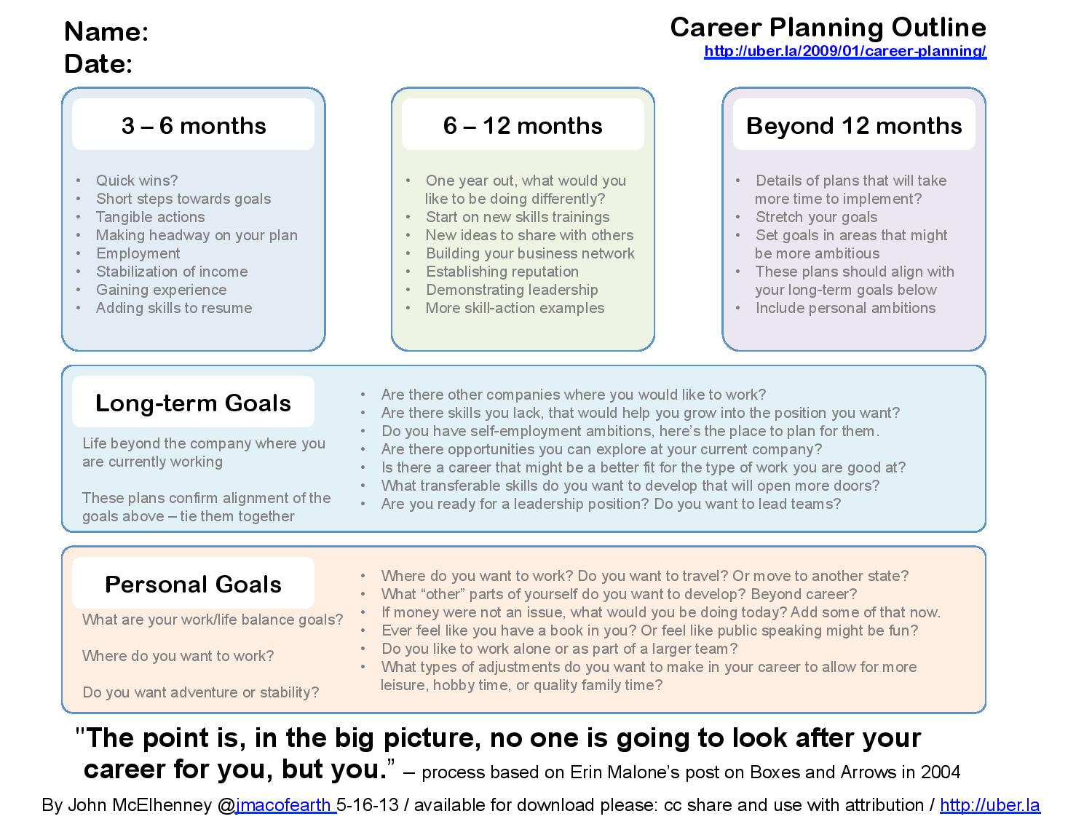
Setting Your Objective
Notes:
OPTIONAL
Focus:
For purposes of this session – and HYF - let’s focus on Professional objectives
Start with where you want to be long term – conceptually and operationally
Shorten the scope, where do I want to be in a year
Questions:
What industry do I want to work in?
What kind of organization do I want to work for?
What skills/knowledge do I need to have in order to achieve my long-term aspirations?
Homework: I will send you a guide that expands on these issues, spend a couple hours thinking it through, write a 2-3 sentence objective that is professional, specific, short-term focused – we will review next week.
Your career objective should combine your
Education
Training, but also
Interests
Preferences

Slide 21
Wrap
Preparing for your interviews
Role profile
Company research
Interview
Notes:
Over the next couple weeks we’ll be conducting PRACTICE INTERVIEWS
Critical point: Through HYF you’ve learned and developed a certain set of skills that will help to prepare you for the future.
But this is just the starting point. It is imperative to continue to learn throughout your career. What will that look like?
Many forms
On the job learning – involvement in particular teams and development projects
Employer sponsored continuing education
Independent continuing education for new skills – many different forms, online for specific skills, workshops, college and university skills
Whatever your future looks like, it is vital to continue to learn and it is vital that YOU take responsibility for your future

